Slide 1
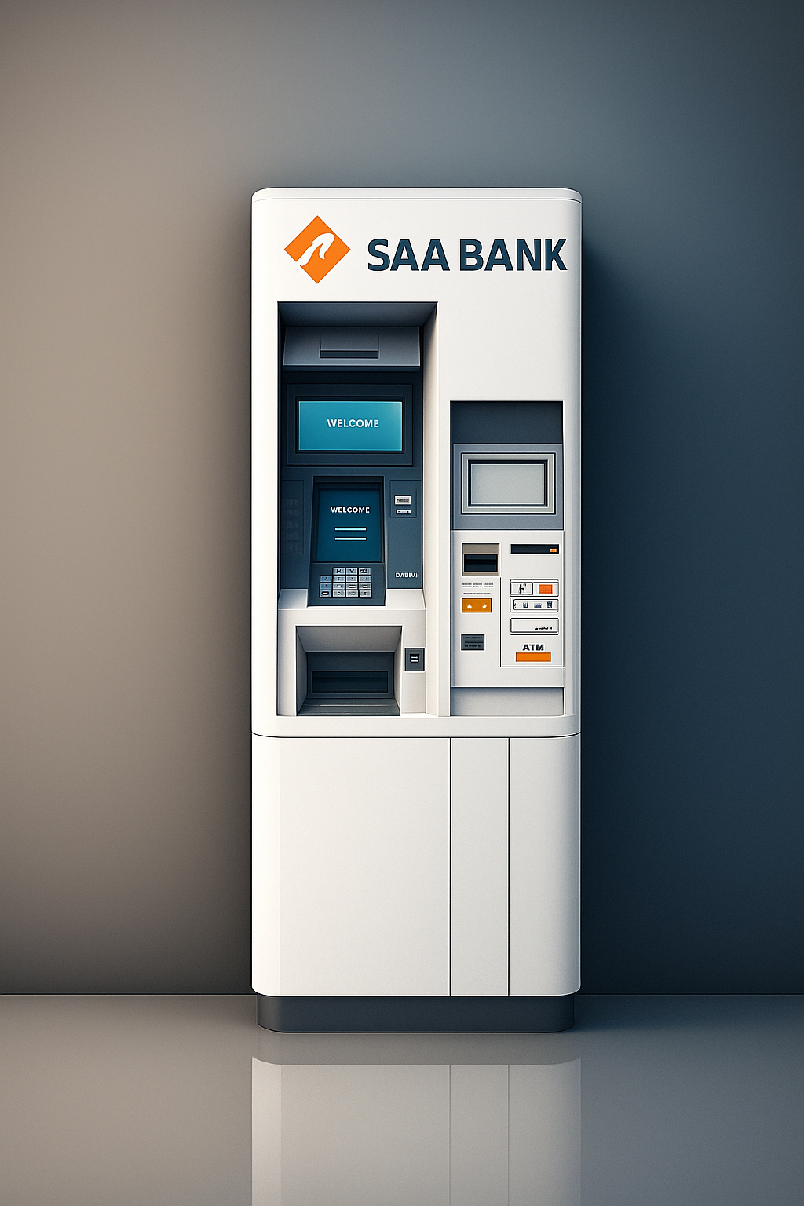

BANKING SYSTEM WITH ATM.
COMPLEX COMPUTING PROBLEM
TEAM NAME: CODE BRUSTERS

Slide 2
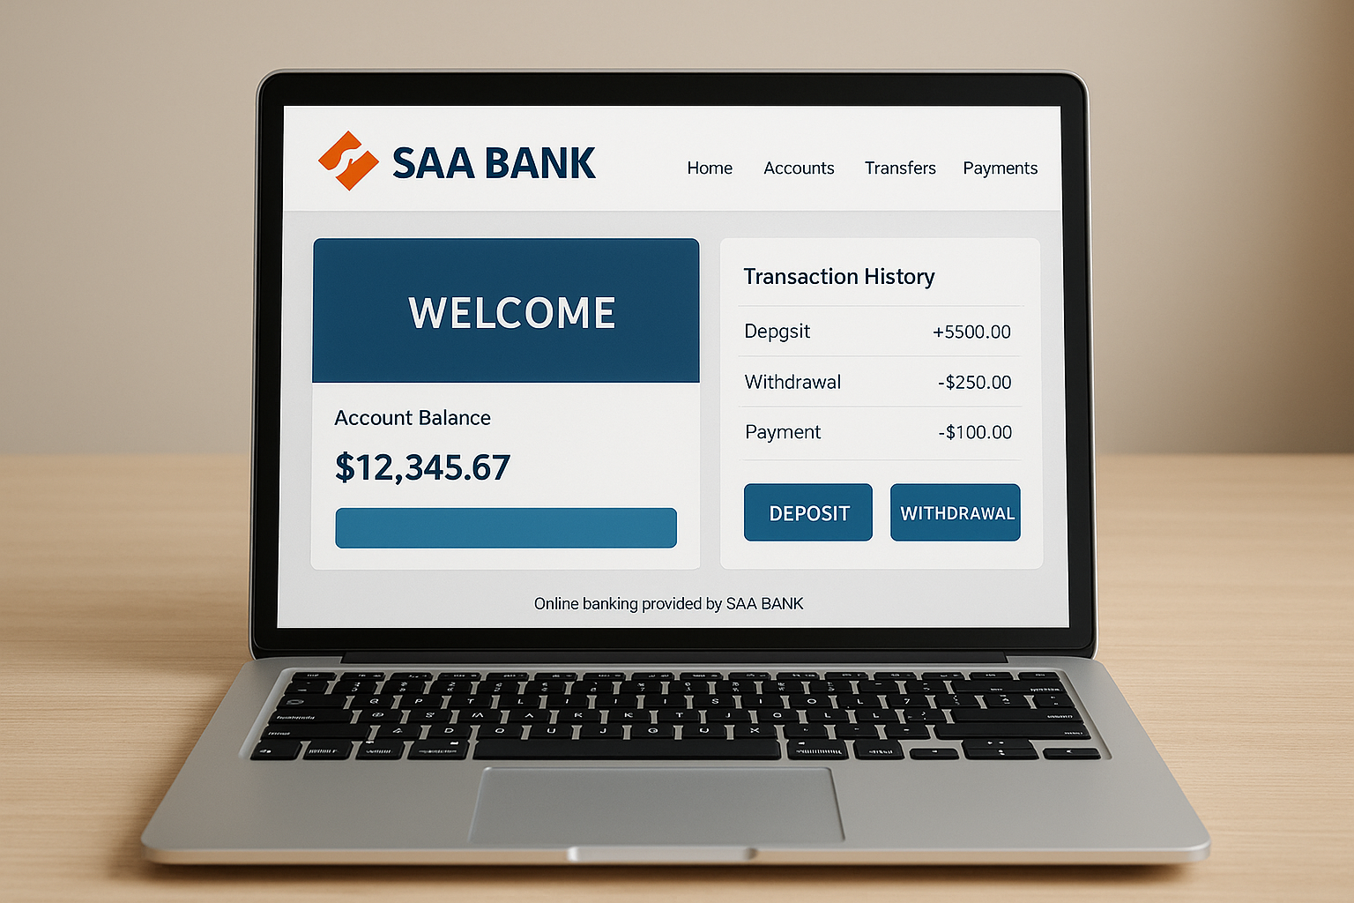
THE FUTURE OF ATM
THIS IS NOT A TYPICAL ATM MACHINE IT’S A STEP TOWARDS FUTURE WHERE ATM COMES AT HOME

Slide 3
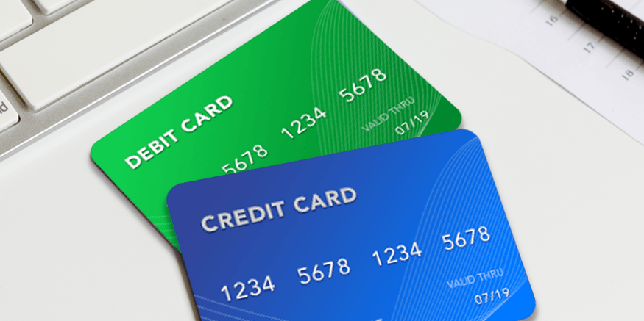
KEY FEATURES
Users can create an account and set a password to access the ATM. The account information is stored in a file, so it remains available even after the program ends.
User can used ATM with Both Debit and Credit Card.

Slide 4
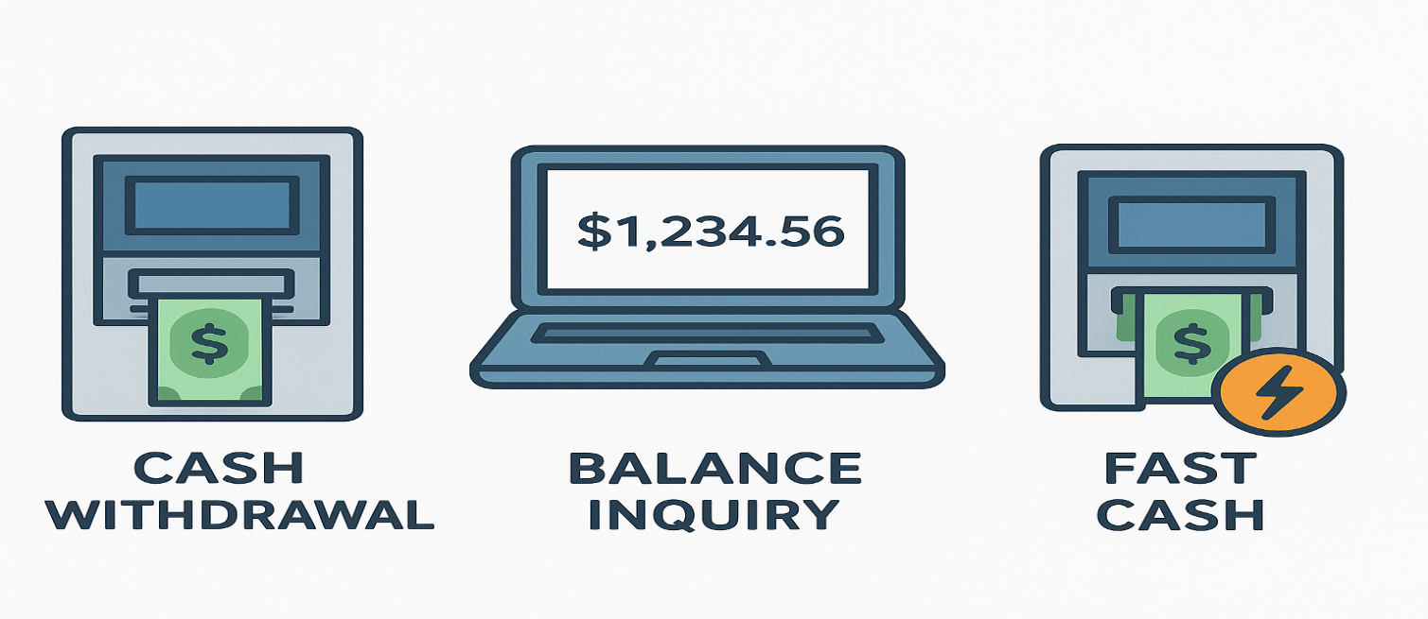
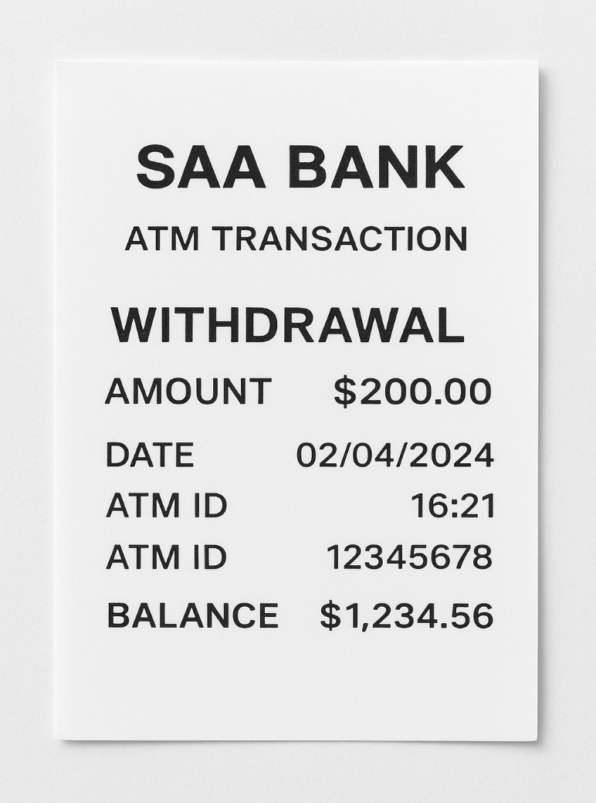
User can avail All features Like Deposit, WithDrawal , Check Balance, and Fast Cash.
User can Get a slip after its
Transaction if it required.

Slide 5
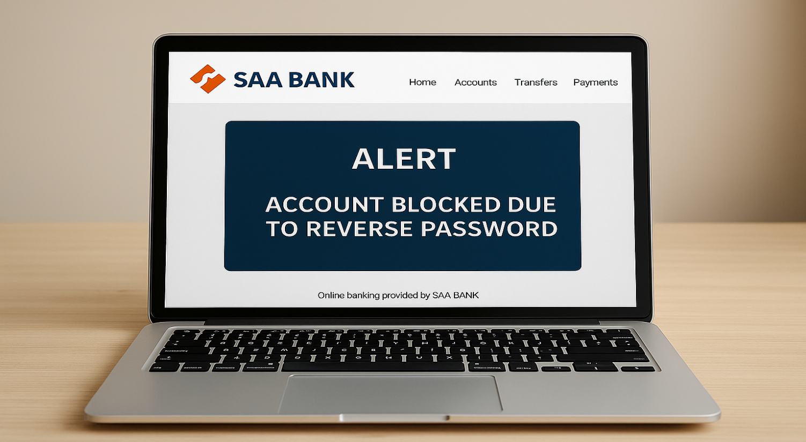
SECURITY FEATURES
We apply a Safety Checker that blocks the card and stops all payments if the user enters their password in reverse order.

Slide 6
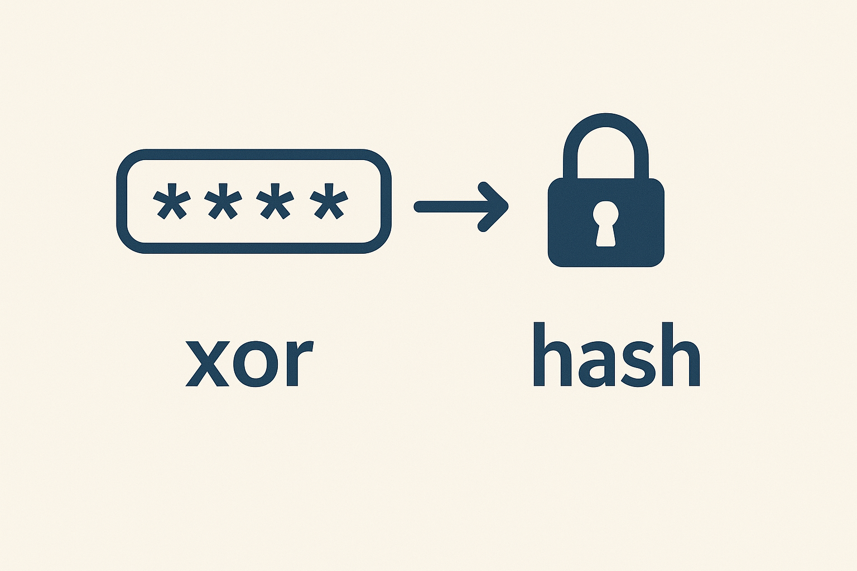
We also apply Hashing on Password so that Password remain save and not be Hacked by using a technique Known as “XOR CIPHER”.

Slide 7
FUTURE GOALS
Insha’Allah, in the future, we will create a GUI interface for this app. Once the teleportation feature is functional, we will also develop a system that allows users to deposit money into their bank accounts through their laptops or other devices.

Slide 8


